Slide 1
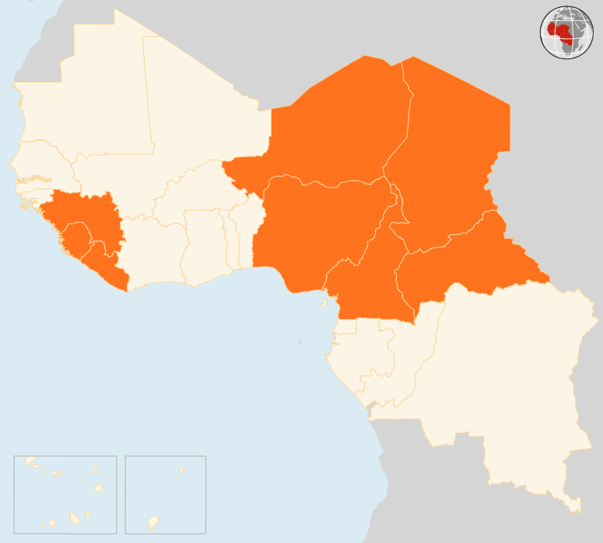

10 – 16 Nov 2015
CAMEROON
CHOLERA OUTBREAK IN NORTH REGION
A cholera outbreak has erupted in North region. Over the past month, 36 cases have been reported, 30 of them treated. No fatalities have been recorded so far. Preventive medical measures, treatment as well as population sensitization are ongoing.
CENTRAL AFRICAN REPUBLIC (CAR)
SEVEN KILLED IN CLASHES
At least seven people were killed and hundreds of shelters for internally displaced persons (IDPs) torched following intercommunal fighting that erupted on 10 November in the western Batangafo locality. Armed men also looted the premises of a humanitarian organization. Around 30,000 IDPs have now sought safety at various military and NGO compounds in the area. Water and emergency latrines are the most critical needs.
CHAD
STATE OF EMERGENCY DECLARED IN LAC REGION
The Chadian Government on 9 November declared a state of emergency in Lac region owing to increasing attacks by suspected Boko Haram members. Under the state of emergency, the Governor of the region can restrict movement of people and vehicles and search homes among other measures. The Government also announced the release of US $4.8 million to boost agriculture, pastoralism, education and health among others in the region.
NIGER
GUNMEN RAID VILLAGE IN BOSSO
Suspected Boko Haram gunmen raided a village in the south-eastern Bosso area on 11 November, killing five civilians. The Nigeria-based armed group has been blamed for a series of attacks on Bosso and neighbouring Diffa region since early this year.
NIGERIA
ARMY FREES 61 IN BORNO
The Nigerian army said on 12 November it had rescued 61 people, mainly women and children, during an operation against Boko Haram in Borno State. Last month, the army had announced rescuing more than 330 people, also mostly women and children, held by the armed group in their Sambisa forest hideout.
EVD REGIONAL
LAST PATIENT IN GUINEA DISCHARGED
Guinea’s last confirmed Ebola case, an 18-day-old baby, has been discharged from an Ebola treatment centre in Conakry. If no new cases emerge in the next 42 days, WHO can declare Guinea free of Ebola transmission. Over the weekend, the last 68 Ebola contacts under surveillance had already been released from quarantine. In Liberia, which was declared Ebola-free on 3 September, Ebola Treatment Units (ETUs) are being closed down across the country except those in Lofa county near the border with Guinea. Meanwhile, ETUs are being set up in permanent health facilities.
NIGER
5
KILLED IN ATTACK
IN BOSSO
CHAD
STATE OF EMERGENCY IN LAC REGION
NIGERIA
61
FREED
BY ARMY
CAR
7
KILLED IN CLASHES
EVD REGIONAL
CAMEROON
0
CASES, LAST PATIENT DISCHARGED IN GUINEA
36
CHOLERA CASES
Creation date: 17 November 2015 Map data sources: UNCS, DevInfo, OCHA. Feedback: ocharowca@un.org
The boundaries and names shown and the designations used on this map do not imply official endorsement or acceptance by the United Nations.

